Slide 1
Spring Batch
Introduction and practical use-cases

Slide 2
What is Batch?
no user-interaction
long running process
mostly sequential
onetime, daily, monthly, yearly, ...

Slide 3
Why use Batch?
Easy to configure.
Declarative Vs. Programmatic
Easy to manage.
Existing infrastructure - Spring Batch Admin

Slide 4
Basic Architecutre
JobLauncher
Job
Step
Type1
Tasklet
Type2
Item Reader
Item Writer
Item Processor

Slide 5
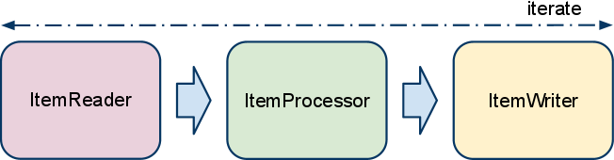
Basic Architecture - Cont.

Slide 6
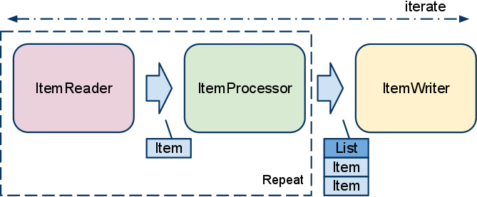
Basic Architecture - Cont. - Chunk

Slide 7
Readers
FlatFileItemReader
JdbcCursorItemReader
JdbcPagingItemReader
HibernateCursorItemReader
IbatisPagingItemReader
JmsItemReader

Slide 8
Writers
FlatFileItemWriter
HibernateItemWriter
JdbcBatchItemWriter
JpaItemWriter
StaxEventItemWriter
etc.

Slide 9
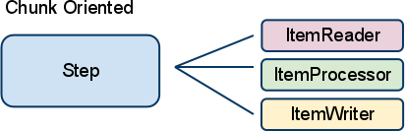
Step

Slide 10
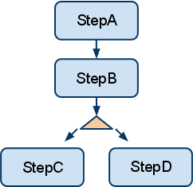
Step Flow

Slide 11
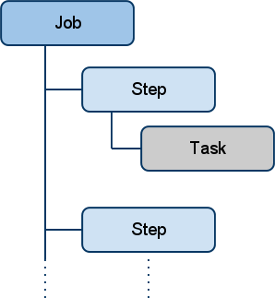
Job

Slide 12
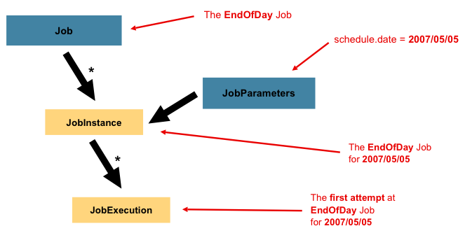
Job Execution

Slide 13
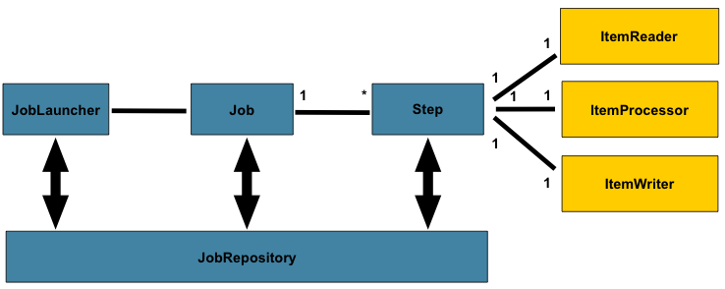
Job Repository

Slide 14
Appnexus Load - Basic
<batch:job id="countryLoadJob">
<batch:step id="step1">
<batch:tasklet ref="countryLoadTasklet" />
<batch:next on="CONTINUE*" to="step1" />
<batch:end on="END" />
<batch:listeners>
<batch:listener ref="pagingAwareStepExecutionListener" />
</batch:listeners>
</batch:step>
</batch:job>

Slide 15
Appnexus Load - Advanced
<batch:job id="domainReportLoadJob">
<batch:step id="step1" next="step2">
<batch:tasklet ref="domainReportRequestTasklet" />
</batch:step>
<batch:step id="step2" next="step3">
<batch:tasklet ref="domainReportStatusTasklet" />
</batch:step>
<batch:step id="step3">
<batch:tasklet ref="domainReportDownloadTasklet" />
</batch:step>
</batch:job>

Slide 16
Spring Batch Admin
http://staging.cms.mediaiqdigital.com/appnexus-load/jobs/executions/11

Slide 17
Thanks

